Slide 1
Datacenter Hard Drive Failure Rate
By Nathan McGugan - 3714794

Slide 2

Data
Hard Drive Data and Stats from Backblaze
Lists all the hard drives for each day and their status
Provides the model, serial number, and SMART stats for each drive
Date range: Jan 1st 2016 to June 30th 2023

Slide 3
Initial Hypothesis
As a hard drive gets older, the probability of failure increases

Slide 4
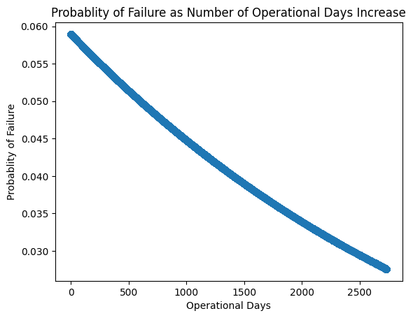
Logistic Regression

Slide 5
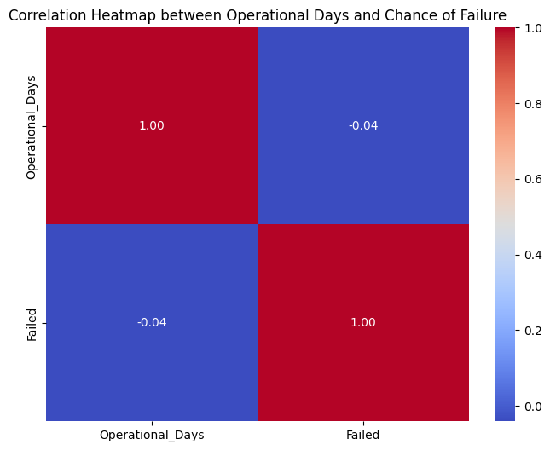
Correlation Heat Map

Slide 6
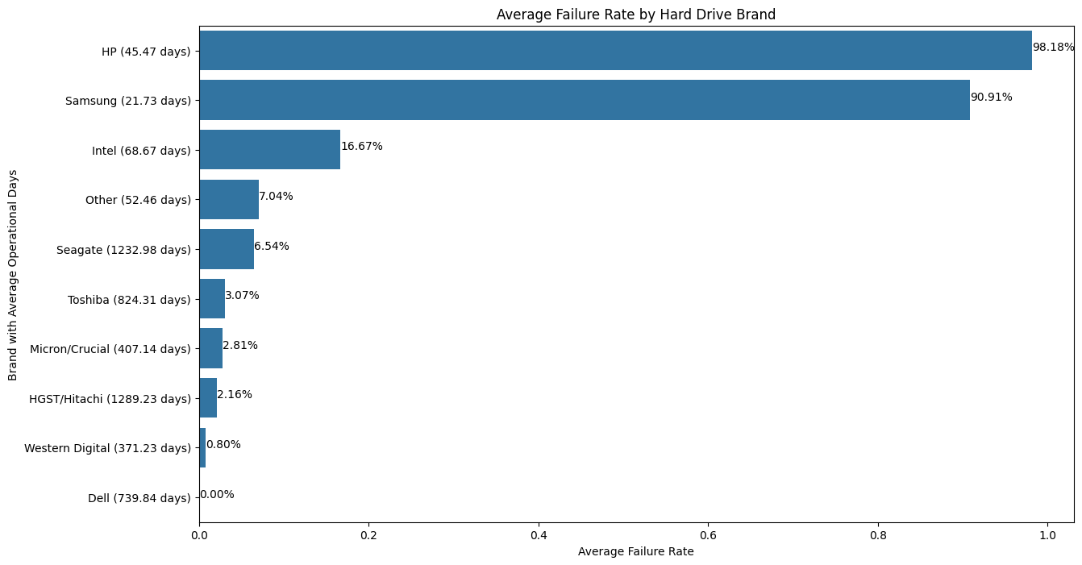
Average Failures for Each Brand

Slide 7
Code Review/Demonstration

